Slide 1
PYTHON
Module 4
List,Tuple,Set,Dictionaries
Presentation by: Gopinath.G

Slide 2
Python - Lists
Python - Access List Items
Python - Change List Items
Python - Add List Items
Python - Remove List Items
Python - Loop Lists
Python - List Comprehension
Python - Sort Lists
Python - Copy Lists
Python - Join Lists
Python - List Methods

Slide 3
Accessing a list
List is one of the built-in data types in Python. A Python list is a sequence of comma separated items, enclosed in square brackets [ ]. The items in a Python list need not be of the same data type.
a list is a sequence. Each object in the list is accessible with its index. The index starts from 0. Index or the last item in the list
a= list[i]

Slide 4
Change List Items, Add List Items, Remove List Items,for loop
Change Item Value
Change a Range of Item Values
Insert Items
Add items: Append Items: add an item to the end of the list, use the append() module.
To insert a list item at a specified index, use the insert() method.
append elements from another list to the current list, use the extend() method.

Slide 5
Remove Specified Item remove().
Remove Specified Index pop().
del keyword also removes the specified index.
Clear the List clear().
Loop Through a List for loop.
Loop Through the Index Numbers.
You can also loop through the list items by referring to their index number.
range() and len()functions to create a suitable iterable.
Using a While Loop.
Looping Using List Comprehension.
List Comprehension.
List comprehension offers a shorter syntax when you want to create a new list based on the values of an existing list.
The Syntax:
newlist = [expression for item in iterable if condition == True]
Example for each

Slide 6
Tuples
Tuples are used to store multiple items in a single variable.
Tuple is one of 4 built-in data types in Python used to store collections of data,
the other 3 are List, Set, and Dictionary, all with different qualities and usage.
A tuple is a collection which is ordered and unchangeable.
Are written with( )
Allow Duplicates
Access Tuple Items: print(a[1])
Check if Item Exists: if “ball" in tuple
Change Tuple Values
Once a tuple is created, you cannot change its values. Tuples are unchangeable, or immutable as it also is called
To insert a element in tuple
1. Convert into a list: Just like the workaround for changing a tuple,
you can convert it into a list, add your item(s), and convert it back into a tuple.
2. Add tuple to a tuple. You are allowed to add tuples to tuples,
so if you want to add one item, (or many), create a new tuple with the item(s), and add it to the existing tuple:

Slide 7
Unpacking a Tuple
When we create a tuple, we normally assign values to it. This is called "packing" a tuple
Using Asterisk *
If the number of variables is less than the number of values, you can add an *
to the variable name and the values will be assigned to the variable as a list.
Loop Through a Tuple
You can loop through the tuple items by using a for loop
Loop Through the Index Numbers
You can also loop through the tuple items by referring to their index number.
Using range and len functions
Using a While Loop
You can loop through the tuple items by using a while loop using len function
Example for each

Slide 8
Python Sets
Sets are used to store multiple items in a single variable.
Set is one of 4 built-in data types in Python used to store collections of data,
the other 3 are List, Tuple, and Dictionary, all with different qualities and usage.
A set is a collection which is unordered, unchangeable*, and unindexed.
Set items are unchangeable, but you can remove items and add new items.
Length of a Set
type()
Access Items
you cannot access items in a set by referring to an index or a key.
But you can loop through the set items using a for loop, or ask if a
specified value is present in a set, by using the in keyword
Add Items add()
Add sets update()
Remove item in a set remove()
discard()
pop()
Looping a set is done by for loop.
Example for each

Slide 9
Python Dictionaries
Dictionaries are used to store data values in key:value pairs.
A dictionary is a collection which is ordered*, changeable and do not allow duplicates.
Dictionaries are written with curly brackets, and have keys and values.
Dictionary Items
Dictionary items are ordered, changeable, and does not allow duplicates.
Dictionary items are presented in key:value pairs, and can be referred to by using the key name.
Accessing Items
You can access the items of a dictionary by referring to its key name, inside square brackets
Get Keys: keys() method return list of key in dictionaries
Get values: values() method return all the values in list form.
Get Items
The items() method will return each item in a dictionary, as tuples in a list.
Update Dictionary: update()
popitem(), del()
Loop Through a Dictionary using for .
Nested Dictionaries:A dictionary can contain dictionaries, this is called nested dictionaries.
copy() use to copy a dictionaries
Example for each.

Slide 10
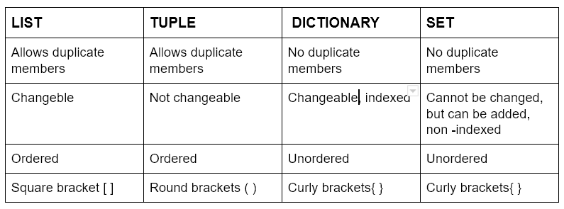
Difference between list, tuple, dictionary, set

Slide 11
THANKYOU..!

